Slide 1
Teaching spatial data analysis
A case study with recommendations

Slide 2
Spatial Data Analysis
Spatial data analysis may take many forms:
Accessibility (e.g., analysis of distance from points
Analysis of points over space (point-reference)
Areal Data (aggregate units)
Spatial data analysis can provide important information about:
The distribution of services or funds
Contextual information for program planning

Slide 3
Case Study

Slide 4
Why does the spatial arrangement of nonprofits matter?
Case study
For residents:
Service access is increased nearby
Nonprofit density nay enhance neighborhood processes, including social networks and their benefits (social capital)
Strengthen the ability of residents to solve collective action problems
For organizations
Co-location provides the increased resource access, including economic networks, volunteers, employees, and legitimacy

Slide 5
Understanding the nonprofit sector
Case study
The most common measure is Nonprofit Density
Nonprofit density typically refers to then number of nonprofits in a unit
Sometimes, it is the number of nonprofits per capita
Do you see any limitations of this measure?

Slide 6
Understanding the nonprofit sector
Case study
While the available data are often most accurate for density, it is typically a crude indicator
It does not measure the size of organizations, or their activity.
One way to redress this issue is by considering nonprofit mass (typically expenses or revenue).

Slide 7
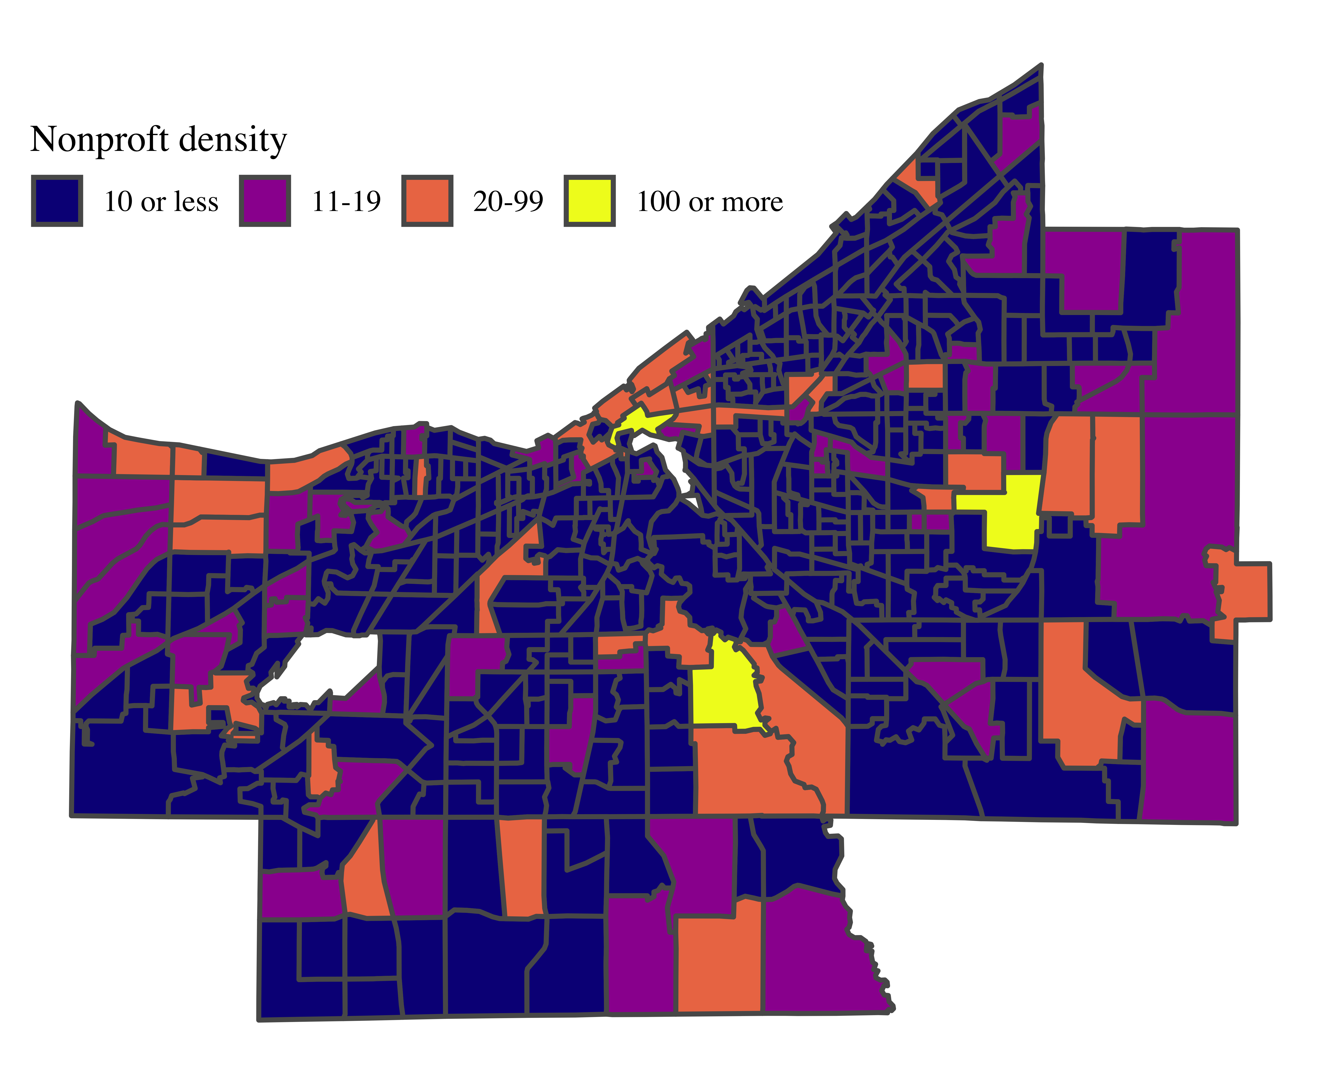
Cuyahoga County’s
Nonprofit sector
Aggregated by census tract we see an average of 8.5 nonprofits per tract
But where are they?
Can you identify industrial clusters?
Intuitively, how do you think about clustering?

Slide 8
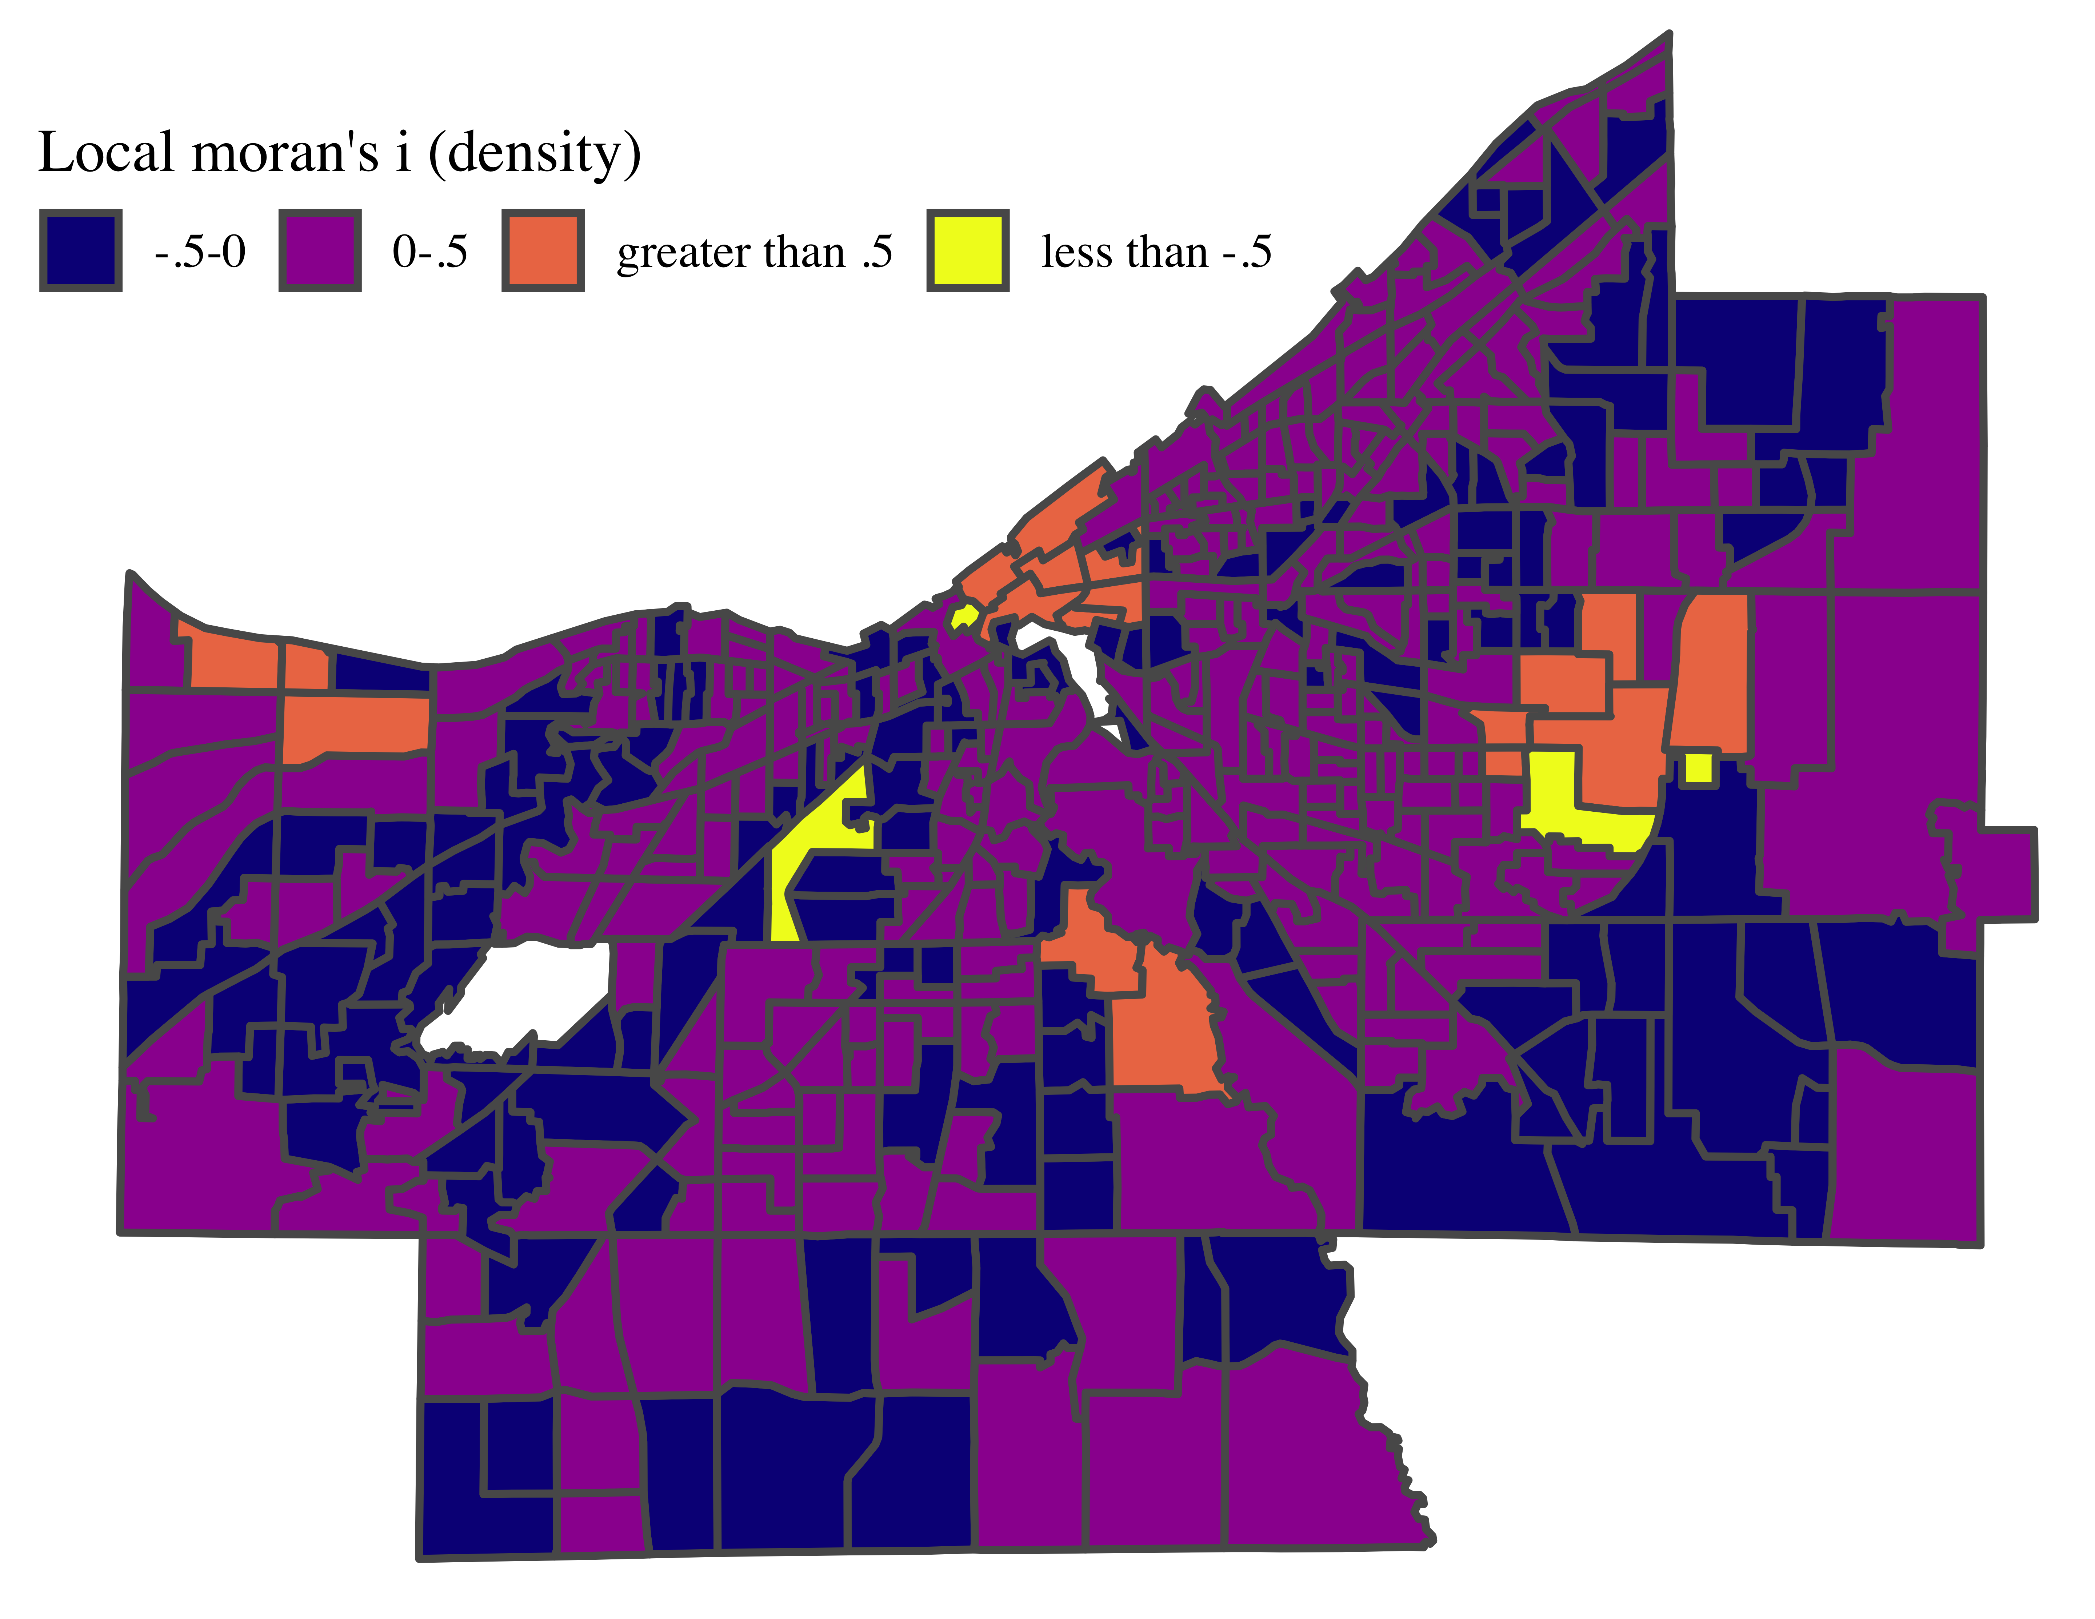
Cuyahoga County’s
Nonprofit sector
Moran’s I - a common measure of spatial autocorrelation, requires a definition of neighbors.
Given a set of neighbors, Moran’s I compares a unit to its neighbors, and then to the sample.
If the unit is above the sample average, and so are their neighbors, we see a positive I

Slide 9
Imagine you are presenting your work to a policy maker, describing the sector
What other information would you want to consider?

Slide 10
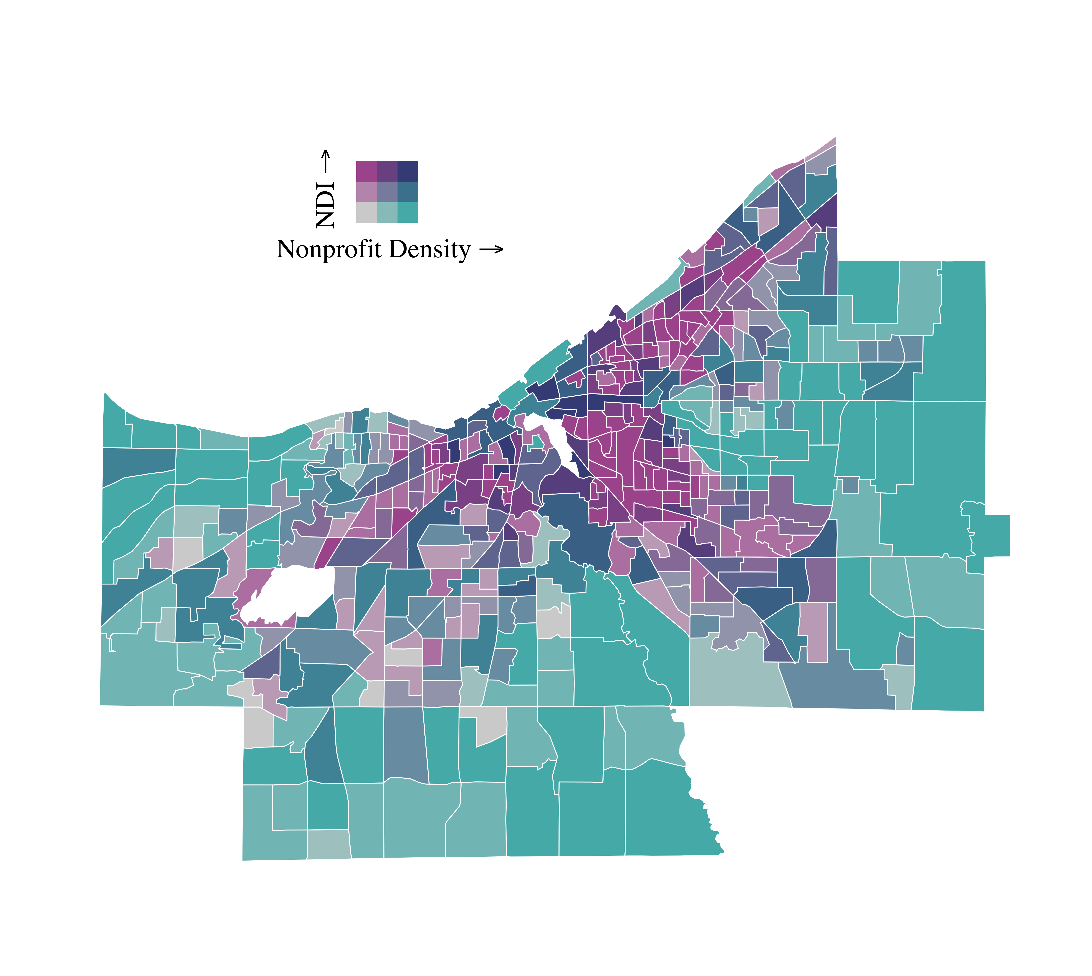
Bivariate mapping
Given the local benefits of nonprofits, you may wish to discuss the distribution of nonprofits with respect to need.
Here we consider a bivariate map: density and the neighborhood deprivation index, a factor variable measuring the relative deprivation of the tract.
What conclusions do you draw from this map?

Slide 11
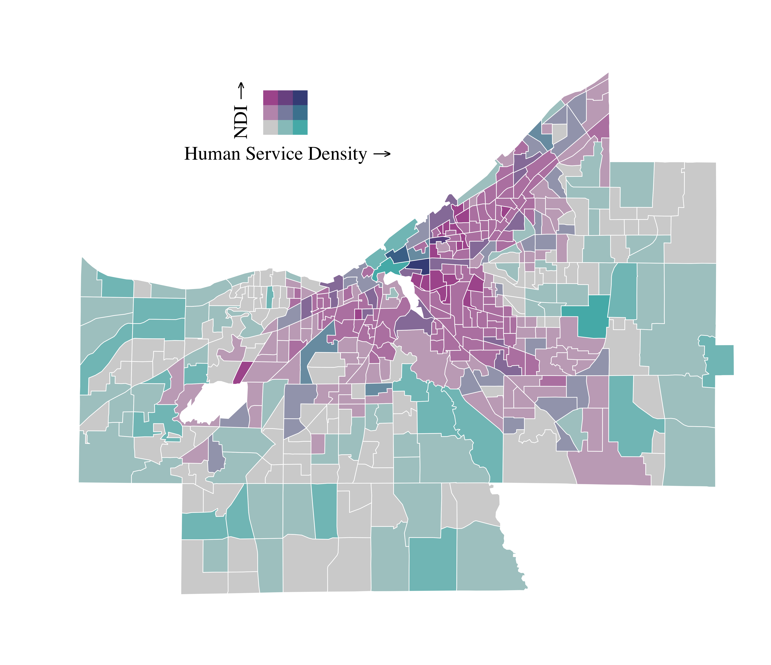
Human Services
While nonprofits provide a range of benefits, human service organizations often provide essential services, making their location a key concern.
This map shows the density of human service organizations and neighborhood deprivation, showing a broad mismatch.

